Slide 1
Sensing Semantics
Ryan Shah and Jacob Pawlak

Slide 2

Background & Purpose
To develop an application that takes large amounts of semantic data and displays it in a unique and creative way.
Notes:
-cathacks
-time limitation

Slide 3


Included Libraries
Natural Language Toolkit
Wordnet
SentiWordNet
Pygame

Slide 4

SentiWordNet
Provides Semantic Data
Nouns, Verbs, Adjectives, Adverbs

Slide 5
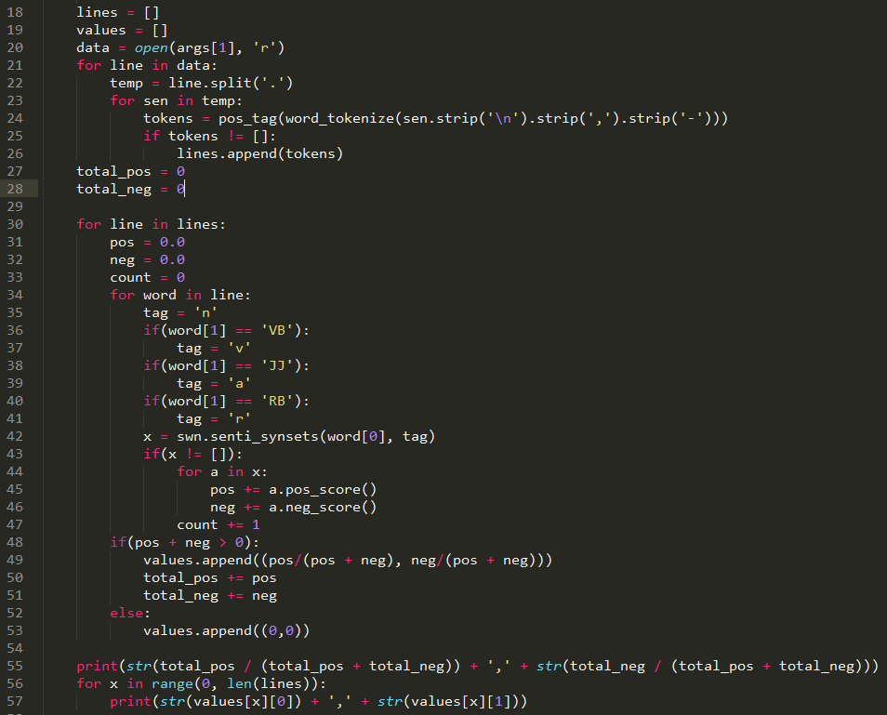
Implementation
Read in Data
Split Sentences
Tag Tokens
Determine Scores

Slide 6
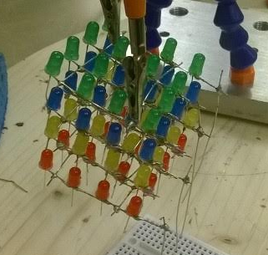
The LED Cube
The idea behind the cube is to present the text data in a multimedia “light show”
The 4x4x4 LED cube consists of 4 different color layers to represent our calculated semantic values (1 - 16, positive and negative)

Slide 7
Hardware Materials Used
Arduino Uno
Prototyping non-solder breadboard and leads
Soldering Iron and rosin core solder
64 LEDs - 16 of each red, blue, yellow and green
16 220 Ohm resistors
22 Gauge craft wire for connecting grounds
Alligator arm helper

Slide 8
Converting Values to Light Patterns
Uses the Semantic Values to determine the corresponding light values and creates Arduino code to display them.
The dataToLight.py makes a unique C file for each input text file
The new C file can then be opened in the Arduino IDE and uploaded to the cube

Slide 9
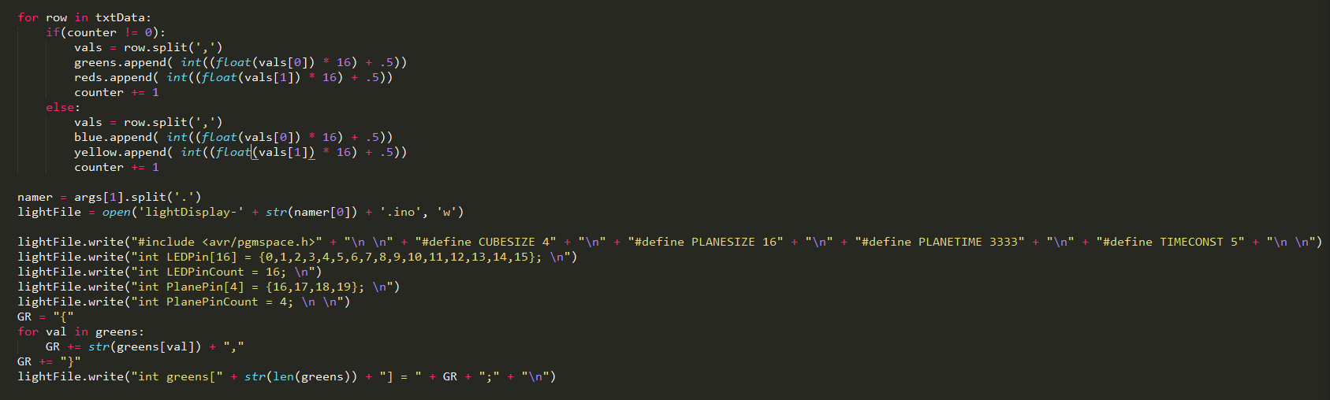
Data to light

Slide 10
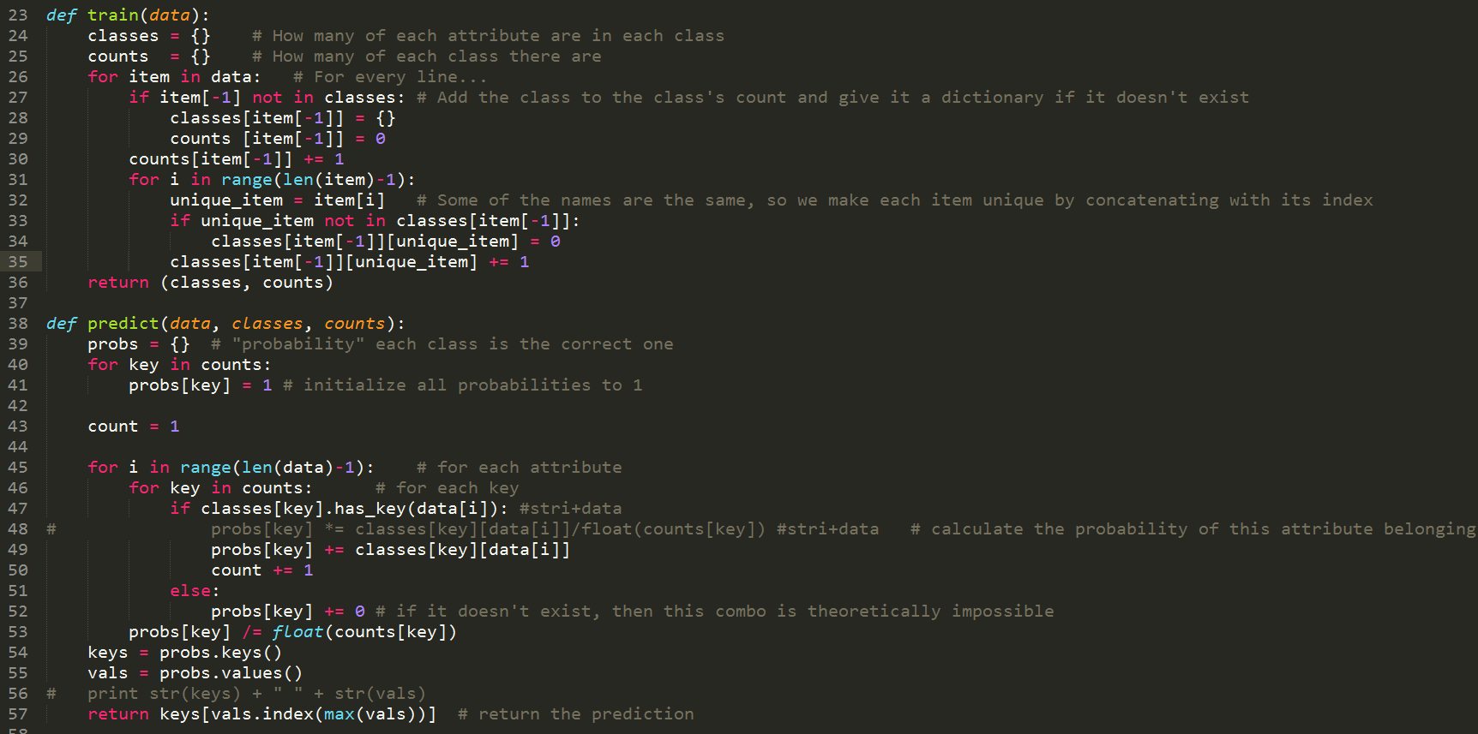
Naïve Bayes

Slide 11
Other Uses
Identification of languages
Topics of Texts
Aid for the Visual/Auditory impaired

Slide 12

Future goals/Questions
Arduino Automation
Tactile Feedback

